Slide 1
10
steps
Start Playing Cashflow Offense,
& stop playing inventory defense
Notes:
Photo by Campaign Creatorson Unsplash

Slide 2
Selling Generates Revenue,
Buying Generates Profit
Foundational Belief in Wholesale/Retail
Notes:
Photo by Campaign Creatorson Unsplash

Slide 3
CHANGE YOUR ATMOSPHERE
REPLENISHMENT BUYER
◦
LANDING SPOT
◦
KPI of TURNS
◦
VERY LITTLE TRAINING
◦
HIDDEN in CORNER
◦
DEAL NEUTRAL
◦
STUCK ON DEFENSE
◦
STAY OUT OF TROUBLE
INVENTORY INVESTOR
◦
CAREER DESTINATION
◦
KPI of NET PROFIT
◦
ONGOING DEVELOPMENT
◦
@ THE CENTER of THE ORG
◦
INNER MARGIN SAVVY
◦
PLAYING OFFENSE
◦
STAND & DELIVER RESULTS

Slide 4
$50 MILLION
INVENTORY ANALYST AKA: BUYER
OPERATIONS
PRODUCT MGR
STORE MGR / SALES

Slide 5
$50 MILLION
16%
NON-STOCK
BASE REPLENISH
9%
INVENTORY ANALYST AKA: BUYER
NEW ITEMS
OPERATIONS
7%
BUY MULTIPLES
8%
MANUAL MINS
42%
SLOW MOVERS
PRODUCT MGR
STORE MGR / SALES
CUST RESERVE
15%

Slide 6
CustReserve% %Non-Stock New% %SlowMovers ManMins% BuyMultDays LeadTime
Play
O F F E N S E
defense
Notes:
Photo by Campaign Creatorson Unsplash

Slide 7
BRANCH / STORE VALUES
NON-STOCK
CUST RESERVED
SLOW (<1Mo)
FORECAST=0
MAN MINIMUMs
ONE DAY INVEN
1
2
3
4
5
7
_____M$ ____%
_____M$ ____%
_____M$ ____%
_____M$ ____%
_____M$ ____%
_____M$ ____%
of Active Items
of Active Items
of Active Items
of Active Items
of Active Items
10%
of Active Items
13%
What % of your Store items are actually being controlled by a fear or gut-based setting? And how does that % total up in Dollars?
15%
22%
What is ONE DAY of $Inventory for your organization?
Every leader and every team member should know this value.
Every component and factor will be multiplied to this value for smarter decisions and strategy.
The key to inventory reduction is to ‘buy later’. Aggressive pre-orders and reserve orders and ‘hide the inventory’ orders drives the inventory up.
Start by seeing how your total Reserve / Allocated $Inventory compares to your total inventory investment. You will likely be inspired to put new rules in place and processes to review and remove.
If the Seasonalized Forecast is ‘0’, then the item is at least for now a Non-Stock item. Therefore, keep watch and make the decision to truly turn the item to Non-Stock if appropriate so that some odd order in 15 months does not trigger a small replenishment buy…
which is often turned into a major purchase due to Buying Multiples.
Most are much better at adding items to the mix than removing them. Our goal is to help you make this task a smart, strategic, ‘Ongoing Process’ rather than a Project!
Inventory Reduction is dramatic with this change in mindset
BUYING MULTs
54%
The Inventory Operating Expense % is extreme on slow movers, often averaging 9% or more. Just like with Non-Stock, this must be an ‘Ongoing Process’ rather than a Project!
Those who excel at Item Mix Mgmt and boldly manage pricing will win
6
__AvgDays __%>90D
of Active Items
50d
What is the Avg BuyMult Days & how much $Inventory has Buy Mults > 90 Days?
B
BENCHMARK

Slide 8
$50 MILLION
STOCK

Slide 9
$50 MILLION
NON
STOCK
16%
1. NON-STOCK
STOCK
1
step

Slide 10
1. NON STOCK INVENTORY
PULL BACK ▪ BALANCE ▪ EXCHANGE
16%
$STOCK vs $NON-STOCK INVENTORY

Slide 11
1. NON STOCK INVENTORY
PULL BACK ▪ BALANCE ▪ EXCHANGE
$STOCK vs $NON-STOCK INVENTORY

Slide 12
1. NON STOCK INVENTORY
PULL BACK ▪ BALANCE ▪ EXCHANGE
YOU
$STOCK vs $NON-STOCK INVENTORY

Slide 13
$50 MILLION
NON
STOCK
1. NON-STOCK
STOCK

Slide 14
$57 MILLION
NON
STOCK
1. NON-STOCK
STOCK
2
step
15%
2. CUSTOMER RESERVE / ALLOCATED

Slide 15
2. CUSTOMER RESERVE / ALLOCATED
ALL STORES = 15%
$CUSTOMER ALLOCATED% of $ON HAND

Slide 16
2. CUSTOMER ALLOCATIONS
SALES REP AVERAGE = 15%
$CUSTOMER ALLOCATED% of $ON HAND

Slide 17
2. CUSTOMER ALLOCATIONS
GROWING OVER TIME?
$CUSTOMER ALLOCATED% of $ON HAND

Slide 18
2. CUSTOMER ALLOCATIONS
PEER BENCHMARKING
YOU
$CUSTOMER ALLOCATED% of $ON HAND

Slide 19
$50 MILLION
NON
STOCK
1. NON-STOCK
STOCK
42%
3. SLOW MOVERS (<1/Mo)
3
step
2. RESERVE ALLOCATED

Slide 20
3. SLOW MOVER MGMT
EX: FORECAST < 1/MO
42%
%SLOW MOVERS % OF TOTAL

Slide 21
3. SLOW MOVER MGMT
EX: FORECAST < 1/MO
%SLOW MOVERS % OF TOTAL

Slide 22
3. SLOW MOVER MGMT
EX: FORECAST < 1/MO
YOU
%SLOW MOVERS % OF TOTAL

Slide 23
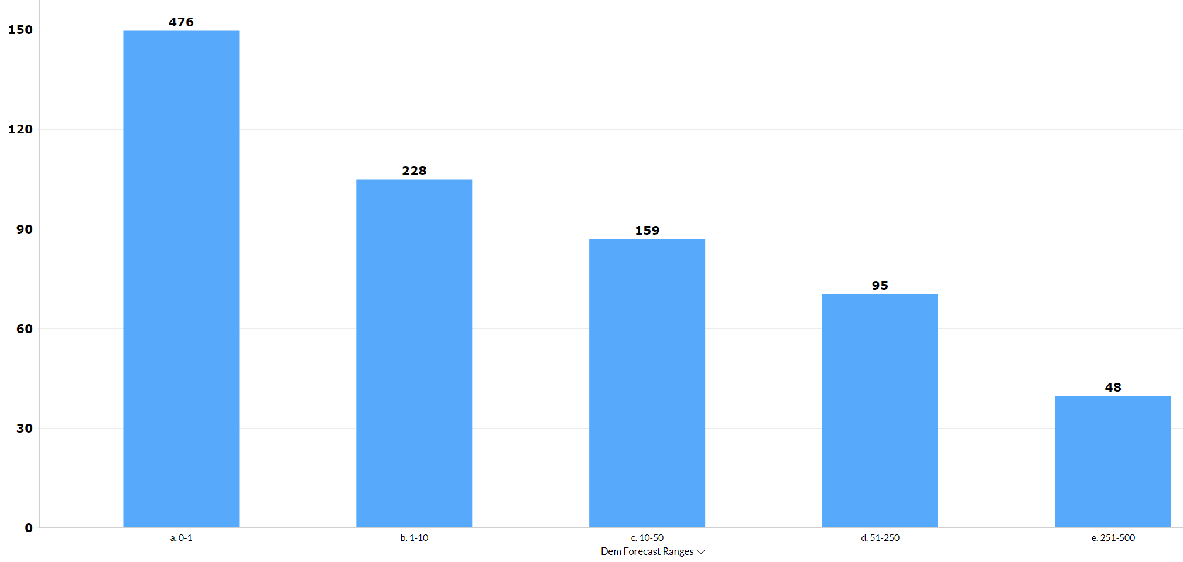
$50 MILLION
42%
SLOW MOVERS
(<1/Mo)

Slide 24
$50 MILLION
NON
STOCK
1. NON-STOCK
8%
4. MANUAL MINIMUMS
STOCK
3. SLOW MOVERS
4
step
2. RESERVE ALLOCATED

Slide 25
4. MANUAL MINIMUMS
NOT TRUSTING THE NUMBERS
MANUAL MINs

Slide 26
$50 MILLION
NON
STOCK
1. NON-STOCK
7%
5. BUY MULTIPLES
STOCK
4. MANUAL MINS
3. SLOW MOVERS
5
step
2. RESERVE ALLOCATED

Slide 27
5. BUYING MULTIPLES
AVERAGE BUY MULT IN DAYS
58
MANUAL MINs

Slide 28
5. BUYING MULTIPLES
AVERAGE BUY MULT IN DAYS
%SLOW MOVERS % OF TOTAL

Slide 29
5. BUYING MULTIPLES
AVERAGE BUY MULT IN DAYS
YOU
%SLOW MOVERS % OF TOTAL

Slide 30
$50 MILLION
NON
STOCK
1. NON-STOCK
9%
6. NEW ITEMS
5. BUY MULTIPLES
STOCK
4. MANUAL MINS
3. SLOW MOVERS
6
step
2. RESERVE ALLOCATED

Slide 31
6. NEW ITEM MGMT
NEW IN LAST X MONTHS
9%
%NEW ITEMS OF TOTAL

Slide 32
6. NEW ITEM MGMT
INVENTORY vs SALES
9%
5%
NEW ITEM %INVENTORY & %SALES

Slide 33
6. NEW ITEM MGMT
NEW IN LAST X MONTHS
YOU
9%
%NEW ITEMS OF TOTAL

Slide 34
$50 MILLION
16%
NON-STOCK
BASE REPLENISH
9%
INVENTORY ANALYST AKA: BUYER
NEW ITEMS
OPERATIONS
7%
BUY MULTIPLES
8%
MANUAL MINS
42%
SLOW MOVERS
PRODUCT MGR
STORE MGR
CUST RESERVE
15%

Slide 35
$40 MILLION
10%
NON-STOCK
BASE REPLENISH
INVENTORY ANALYST AKA: BUYER
OPERATIONS
7%
NEW ITEMS
5%
BUY MULTIPLES
5%
MANUAL MINS
35%
SLOW MOVERS
PRODUCT MGR
STORE MGR
CUST RESERVE
8%

Slide 36
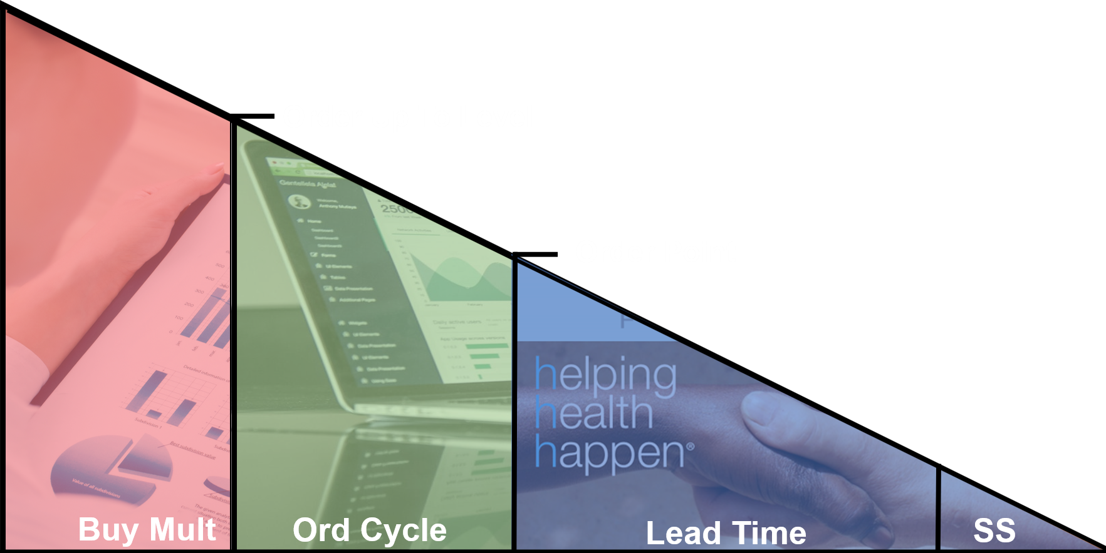
DC REPLENISH COMPONENTS
INVENTORY STRATEGY
ONE DAY of INVEN
______M$______%
Compare each Key Component to the ONE DAY of $Inventory As the Lead Time drop, the Safety Stock will drop!
As you turn the Service Goals down, the Safety Stock will drop.
As you move the Order Cycle u, the Safety Stock will drop
Measure and track these values each week!
8
9
10
ORDER CYCLE DAY$
LEAD TIME DAY$
SAFETY STOCK DAY$
B
18_______
23_______
16_______

Slide 38
ORDER CYCLE
LEAD TIME
SAFETY STOCK

Slide 39
INVENTORY CHAMPIONS
Go Bold Forward Buying
10% Inven Reduction Now!
Increasing your Company’s Inventory IQ
Hiring & Developing
Making a Champion
The One Key to Fill Rates
From Defense to Offense
Inventory Investors
The 10 Vital Numbers for Executives
INVENTORY CHAMPIONS:
A PODCAST
SERIES
INVENTORY EDUCATION & Certification
BENCHMARKING
Best Practice Journey

Slide 40
10
steps
Start Playing Cashflow Offense,
Please Leave a Review!
Notes:
Photo by Campaign Creatorson Unsplash

Slide 41
THE PROFIT JOURNEY
1
DEMAND FORECASTING
2
LEAD TIME FORECASTING
3
ORDER CYCLE MGMT
4
SERV LEVEL (SAF STOCK)
FORECASTING DEEP DIVE
LEAD TIME VISUALIZATION
ORDER CYCLE STRATEGY
SMART SERVICE STRATEGY
Innovative analysis by Inventory Sector
See Lead Times in charts just like you do Demand
A true economic strategy but don’t throw out logic
Your identity is at stake
SEASONAL DEMAND
LT SEASONALITY
ITEM LEVEL ECONOMICS
5
REPLENISHMENT
Foundational Excellence across all locations
As important as Demand Seasonality
For the many, many slow movers in our world
The real buying is done in the previous components
PTD RUNAWAY LINEUP
LT EXCEPTIONS
BUYING MULT STRATEGY
FORWARD BUY STRATEGY
In-Period Exceptions
Bubble the extremes up to the top
Perhaps should be your first project
Play offense and Impact your income statement
NEW ITEM EXCELLENCE
SUPPLIER PERFORMANCE
SHELF LIFE MGMT
EVENT MANAGEMENT
3to1: Spend 3times as much effort on these
Collaborate in pictures from today’s analytics
Know your numbers
Take care of the little things and the big things will work
INNOVATIVE EXCEPTIONS
OPEN ORDER MGMT
MANUAL MINs ANALYSIS
OVERSTOCK MGMT
Today’s Analytics will tell you stories
See your incoming POs in charts and take charge
Where and Who are impacting the strategy?
Set a goal of < 10%

