Slide 1
P4 Inventory
BENCHMARKING
Notes:
Photo by Campaign Creatorson Unsplash

Slide 2
1
INVENTORY
TEAM
OVERVIEW
Key Values
& Benchmark

Slide 3
B
TEAM OVERVIEW
The Analyst’ Desk
AVG SKU COUNT
# SUPPLIERS
WEEKLY PURCHASE $
BENCHMARK
WEEKLY # of POs

Slide 4
B
TEAM OVERVIEW
Team Structure
TOTAL TEAM SIZE
# of ANALYSTS
# of LEADERS / CHAMPIONS / MGRs
BENCHMARK
# SUPPORT PLAYERS

Slide 5
B
TEAM OVERVIEW
Analysts’ Time Investment
BUILDING / PLACING ORDERS
FINE-TUNING SYSTEM SETTINGS
RESPONDING TO REQUESTS/NEEDS
BENCHMARK
MEETINGS

Slide 6
B
TEAM OVERVIEW
Source of Talent
INTERNAL TRANSFER
RECENT COLLEGE GRADUATES
INDUSTRY INV EXPERIENCE
BENCHMARK
OUT OF INDUSTRY EXP

Slide 7
2
SERVICE
Key Values
& Benchmark

Slide 8
S
$ WEIGHTED AVG SERV GOAL
SERVICE LEVEL GOAL
UNIT WEIGHTED AVG SERV GOAL
% ITEMS SLG > 99%
SERVICE
% ITEMS SLG < 95%

Slide 9
3
DEMAND
Key Values
& Benchmark

Slide 10
B
% SEASONAL FORECAST ITEMS
DEMAND
% ITEMS FORECAST < 5/WK
% NEW ITEMS
BENCHMARK
% ON PROMOTION

Slide 11
B
# GROCERY
SKU COUNT
# DAIRY
# GEN MERCH
BENCHMARK
# DAIRY

Slide 12
A
DEMAND FORECAST DEEP DIVE
ANALYTICS
REVENUE
DEMAND FORECASTING
AVG ONE-DAY REVENUE
ACTUAL REVENUE PTD
AVG DEM FORECAST
AVG DEM DEVIATION
$2.6M
$37M
75
32%
PERFORMANCE
TOP 200
NEW
SEASONAL
NON SEASONAL
MANUAL FCST
SHORT ORD CYCLE
FORECAST ACCURACY
+0.7%
-23.5%
+1.1%
-7.3%
-17.7%
+1.9%
+1.5%
+
WATCH
SLOW
SHORT LEAD TIME
LONG LEAD TIME
SHORT LT DEV
PRIV LABEL
+5.3%
+11.9%
-4.5%
+6.3%
-7.5%
+9.0%

Slide 13
4
SUPPLIER
PERFORMANCE
Key Values
& Benchmark

Slide 14
B
AVG LEAD TIME FORECAST
LEAD TIME
AVG LEAD TIME DEVIATION
% ITEMS LT < 5 DAYS
BENCHMARK
% ITEMS LT > 30 DAYS

Slide 15
B
+ OR – SEASONAL LEAD TIME
SUPPLIER
PERFORMANCE
PUT AWAY
SUPPLIER DELIV PERFORMANCE
BENCHMARK
SEASONAL Lt
PUT AWAY
SUPPLIER DELIVERY PERF

Slide 16
A
LEAD
TIME
LEAD TIME DELIVERY
SUPPLIER
OPERATIONS
LEAD TIME DEL L7D
UPCOMING SEASON
SUPP SERV L7D
PUTAWAY L7D
18.1D
+2D
90.5%
1.2D
ANALYTICS
LEAD TIME DEL L30D
SUPP SERV L30D
PUTAWAY L30D
16.2D
93.0%
.5D
PERFORMANCE

Slide 17
5
OPERATIONS
Key Values
& Benchmark

Slide 18
B
VENDOR ORDER CYCLE
ORDER CYCLE
ITEM EFFECTIVE ORDER CYCLE
BUYING MULT DAYS
BENCHMARK
DAYS ON HAND
DAYS ON HAND
ITEM EFFECTIVE ORDER CYCLE
VENDOR ORDER CYCLE
BUYING MULT DAYS

Slide 19
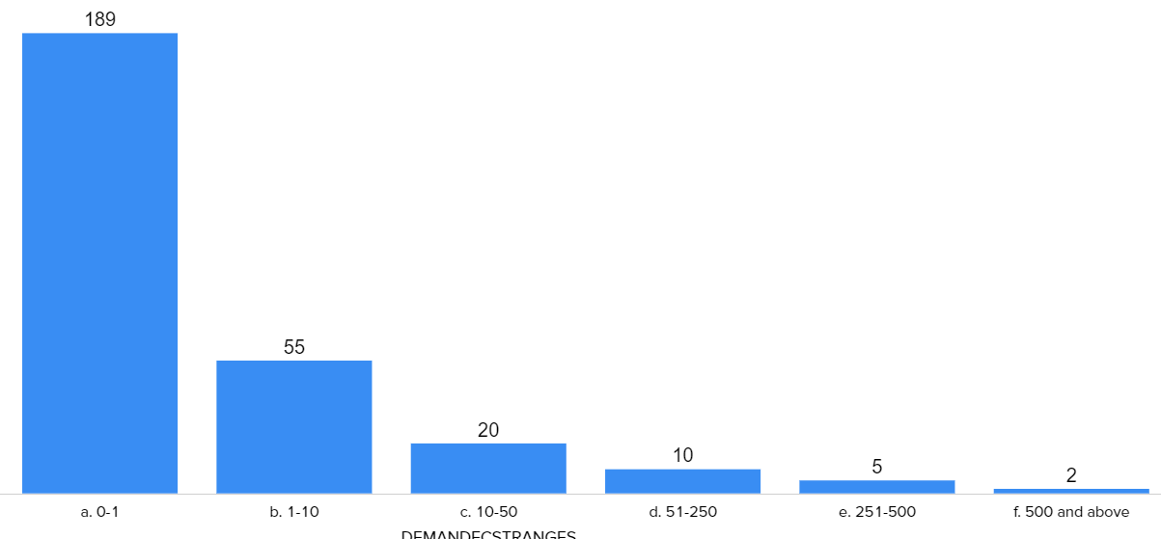
A
ORDER CYCLE
ANALYTICS
EFF ORDER CYCLE
VEN ORDER CYCLE
BUY MULT DAYS
ICYCLE > VCYCLE
ACTUAL LINES YTD 2020
20
14
12
67%
400,000
EXPECT LINES / YEAR
EXPECT ORDERS / YEAR
AVG $ / ORDER
AVG LINES / ORDER
ACTUAL ORDERS YTD 2020
600,000
30,000
$12,000
15
20,000

Slide 20
6
INCOME
STATEMENT
Key Values
& Benchmark

Slide 21
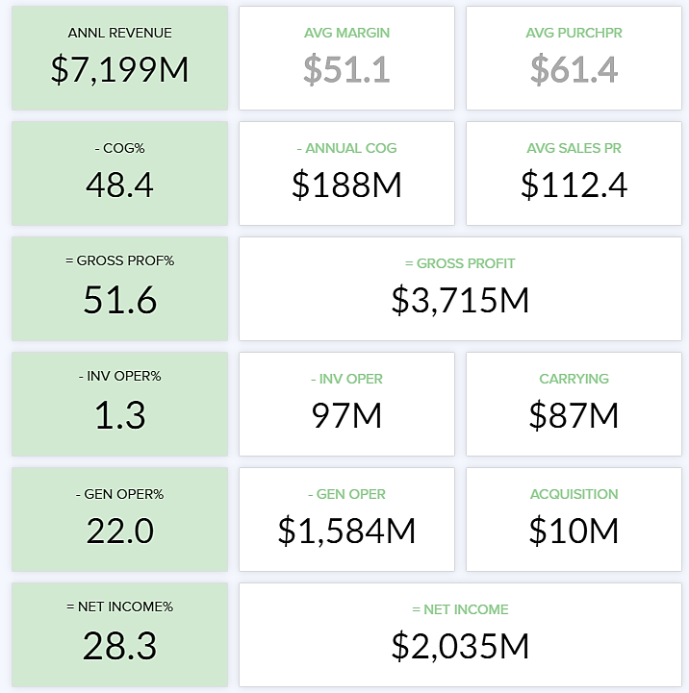
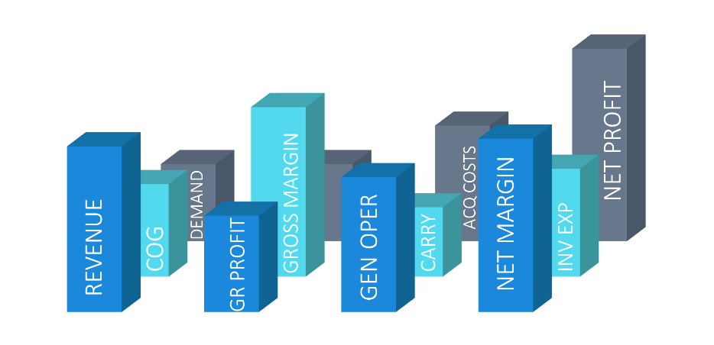
A
CORE FINANCIALS
ANNL REVENUE
- ANNL COGS
AVG PURCH PRICE
ANALYTICS
1,000M
720M
$54
- COGS
AVG ITEM MARGIN
AVG SALES PRICE
72%
$21
$75
= GROSS PROFIT
= GROSS PROFIT
28%
280M
- INV OPER %
- INV OPER
CARRYING
1.5%
15.0M
10M
INVENTORY SECTORS
- GEN OPER %
- GEN OPER
ACQUISITION
TOP 200
SLOW
NEW
IMPORT
PRIVATE LABEL
23%
230M
5.0M
NET INCOME
NET INCOME
NET INCOME
NET INCOME
NET INCOME
5.3%
-1.5%
2.2%
4.7%
5.8%
= NET PROFIT
= NET PROFIT
SEASONAL
NON-SEASONAL
HIGH BM DAYS
HIGH DEM DEV
PROMO
3.5%
35.0M
NET INCOME
NET INCOME
NET INCOME
NET INCOME
NET INCOME
3.8%
2.2%
1.1%
2.3%
2.5%

Slide 22
B
CORE FINANCIALS
ONE DAY OF $ INVENTORY
CARRY COST RATE
CARRY RATE
ACQUISITION COST
BENCHMARK
ONE DAY OF $INVEN
ACUQISITOIN RATE

Slide 23
INVENTORY
BENCHMARKING
SERVICE

Slide 24
P4 Inventory
BENCHMARKING
Notes:
Photo by Campaign Creatorson Unsplash

