Slide 1
INVENTORY FINANCIALS
The 10 Key Values Executives Must Watch

Slide 2
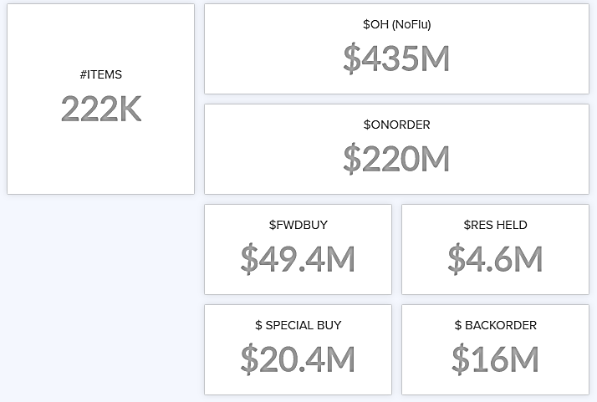
INVENTORY PORTFOLIO
10 KEY VALUES
$ON HAND
begin here
$60 M
# ITEMS
O-STOCK
180K
$ON ORDER
FWD BUY
$25 M
PROMO
1What is One-Day of $Inventory for your business?
1
ONE-DAY INVEN
REPLENISH / SAF STK
FWD BUY
$2.0 M
$38.0 M
$11.0 M
REPLENISH
PROMOTIONAL
OVERSTOCK
$7.0 M
$4.0 M
SAF STK

Slide 3
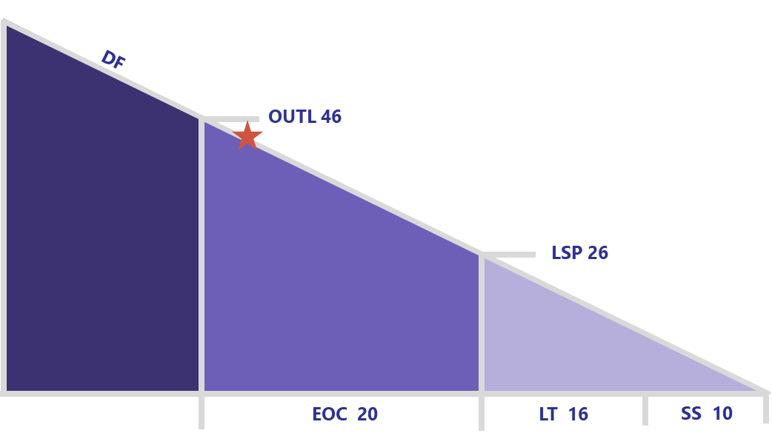
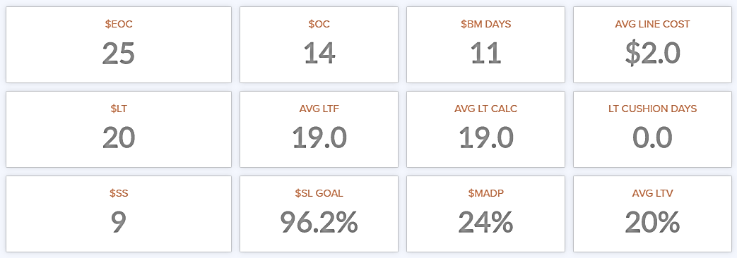
DEPLETION COMPONENTS
2
2,3 DEPLETION
EFF ORDER CYCLE
VOC
BUYMULT DAYS
# ITEMS
20D
14
15
230K
LEAD TIME
LTV
PUTAWAY
SUPPLIER PERF
16D
23%
1.5D
93.5%
2What are your Big3 Inventory Components?
3Where does your Inventory sit today in the picture?
4
4
SAFETY STOCK
SERV LEV GOAL
DEM DEVIATION
AVG DEM FCST
10D
97.5%
32%
74
3
+/- OUTL
DAYS DEL
ON HAND DAYS
ONE-DAY INVEN
-2D
18D
28D
$2.0 M

Slide 4
YOUR SERVICE LEVEL DIAL
4 SERVICE IMAGE
EFF ORDER CYCLE
VOC
BUYMULT DAYS
# ITEMS
20D
14
15
230K
LEAD TIME
LTV
PUTAWAY
SUPPLIER PERF
16D
23%
1.5D
93.5%
4
SAFETY STOCK
SERV LEV GOAL
DEM DEVIATION
AVG DEM FCST
10D
97.5%
32%
74
4What Service-image investment have you chosen
+/- OUTL
DAYS DEL
ON HAND DAYS
ONE-DAY INVEN
-2D
18D
28D
$2.0 M

Slide 5
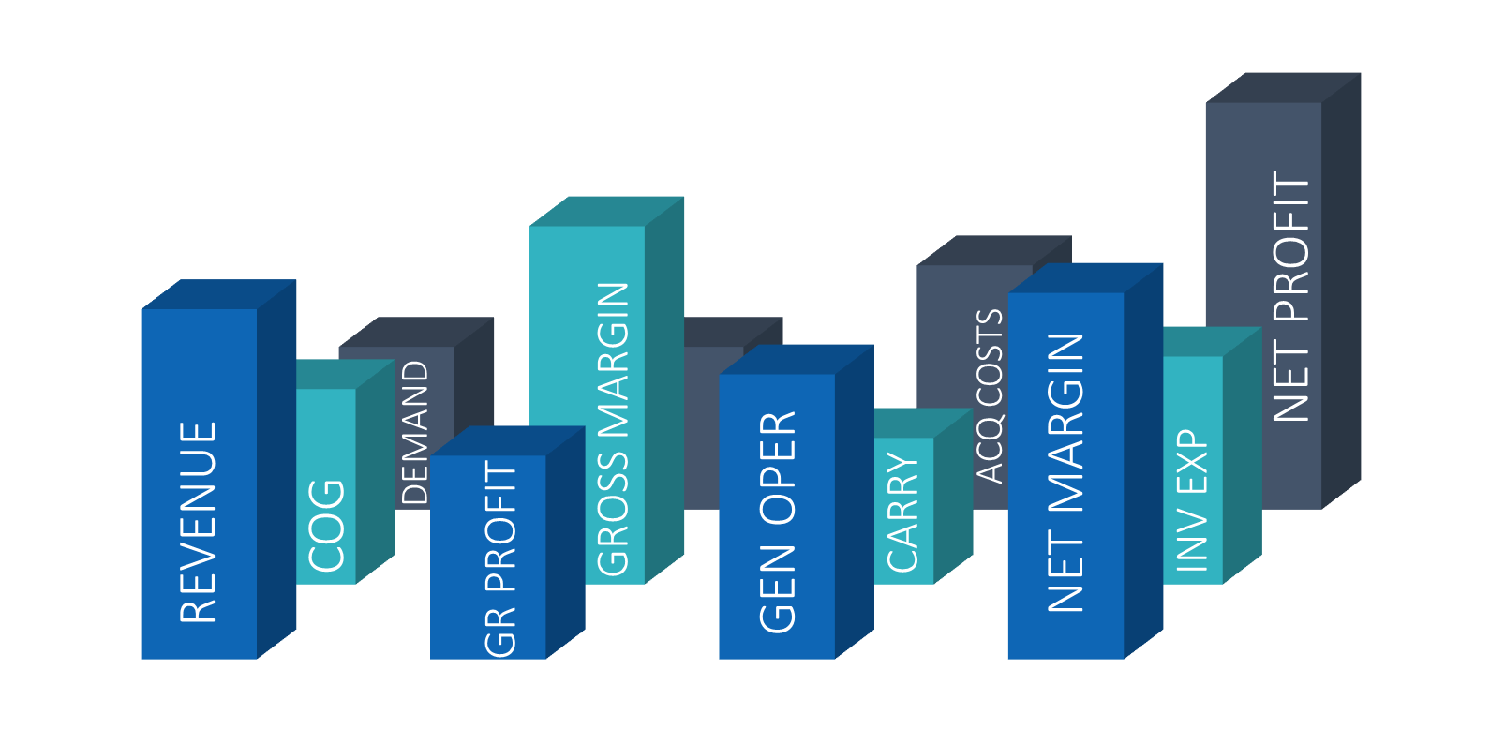
INVENTORY INCOME STATEMENT
ANNL REVENUE
FINANCIAL OVERVIEW
500M
- COGS
72%
= GROSS PROFIT
28%
- INV OPER %
1.5%
- GEN OPER %
23%
5
5Your true Financial Report Card
= NET PROFIT
3.5%

Slide 6
INVENTORY INCOME STATEMENT
ANNL REVENUE
- ANNL COGS
AVG PURCH PRICE
500M
360M
$54
FINANCIAL OVERVIEW
- COGS
AVG ITEM MARGIN
AVG SALES PRICE
72%
$21
$75
= GROSS PROFIT
= GROSS PROFIT
28%
140M
- INV OPER %
- INV OPER
CARRYING
1.5%
7.5M
5M
- GEN OPER %
- GEN OPER
ACQUISITION
23%
115M
2.5M
5
5Your true Financial Report Card
= NET PROFIT
= NET PROFIT
3.5%
17.5M

Slide 7
INVENTORY INCOME STATEMENT
ANNL REVENUE
- ANNL COGS
AVG PURCH PRICE
1,000M
720M
$54
FINANCIAL OVERVIEW
- COGS
AVG ITEM MARGIN
AVG SALES PRICE
72%
$21
$75
= GROSS PROFIT
= GROSS PROFIT
28%
280M
- INV OPER %
- INV OPER
CARRYING
1.5%
15.0M
10M
INVENTORY SECTORS
5
TOP 200
SLOW
NEW
IMPORT
PRIVATE LABEL
- GEN OPER %
- GEN OPER
ACQUISITION
NET INCOME
NET INCOME
NET INCOME
NET INCOME
NET INCOME
23%
230M
5.0M
5.3%
-1.5%
2.2%
4.7%
5.8%
5
SEASONAL
NON-SEASONAL
HIGH BM DAYS
HIGH DEM DEV
PROMO
= NET PROFIT
= NET PROFIT
NET INCOME
NET INCOME
NET INCOME
NET INCOME
NET INCOME
3.5%
3.8%
2.2%
1.1%
2.3%
2.5%
35.0M

Slide 8
DEMAND OVERVIEW
YOUR DEMAND
6
AVG DEM FORECAST
AVG DEM DEVIATION
AVG TRENDING
EXCEPTIONS
75
32%
+8%
9%
6Are your your demand values rising or falling?

Slide 9
DEMAND OVERVIEW
YOUR DEMAND
6
AVG DEM FORECAST
AVG DEM DEVIATION
AVG TRENDING
EXCEPTIONS
75
32%
+8%
9%
PERFORMANCE ACCURACY
TOP 200
NEW
SEASONAL
NON SEASONAL
MANUAL FCST
SHORT ORD CYCLE
FORECAST ACCURACY
+0.7%
-23.5%
+1.1%
-7.3%
-17.7%
+1.9%
+1.5%
WATCH
SLOW
SHORT LEAD TIME
LONG LEAD TIME
SHORT LT DEV
PRIV LABEL
+5.3%
+11.9%
-4.5%
+6.3%
-7.5%
+9.0%

Slide 10
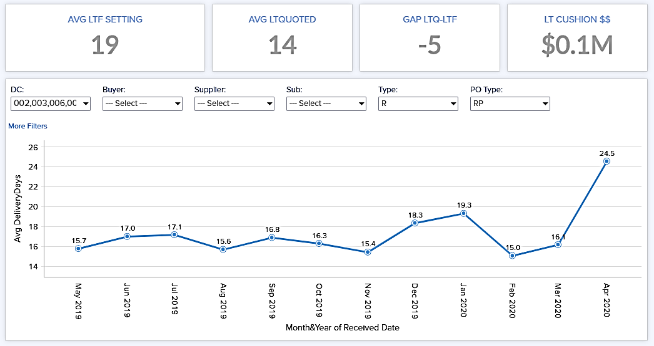
LEAD TIME HIGHLIGHTS
THE SILENT SERVICE KILLER
LEAD TIME FORECAST
LAST PERIOD
NEXT PER SEASON
LAST PER PUTAWAY
16D
15D
17D
1.2D
8
7
7Watch the heavy influence on customer service

Slide 11
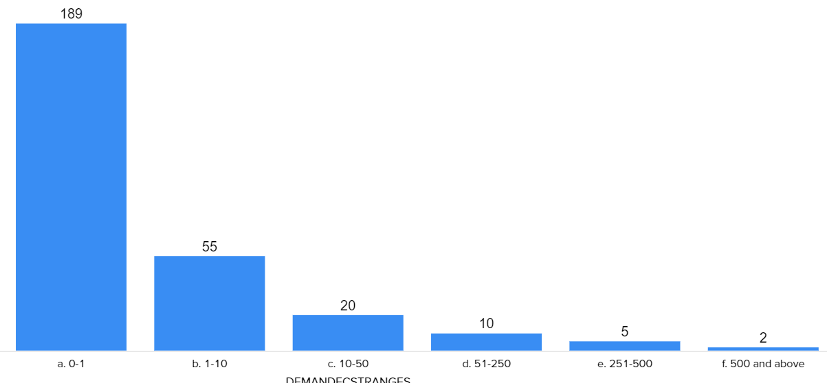
ORDER CYCLE - OPERATIONS
8
ORDER CYCLE
EOC
VOC
BUYMULT DAYS
ICYCLE > VCYCLE
20
14
15
67%
OPEN ORDERS: POs & CASES
PAST DUE POs
PAST DUE CASES
AVG LINES / PO
1200 - 95,000
220
18,000
12.6
8Let us guide you to efficiency and inventory reduction through
Intelligent Buying Multiples

Slide 12
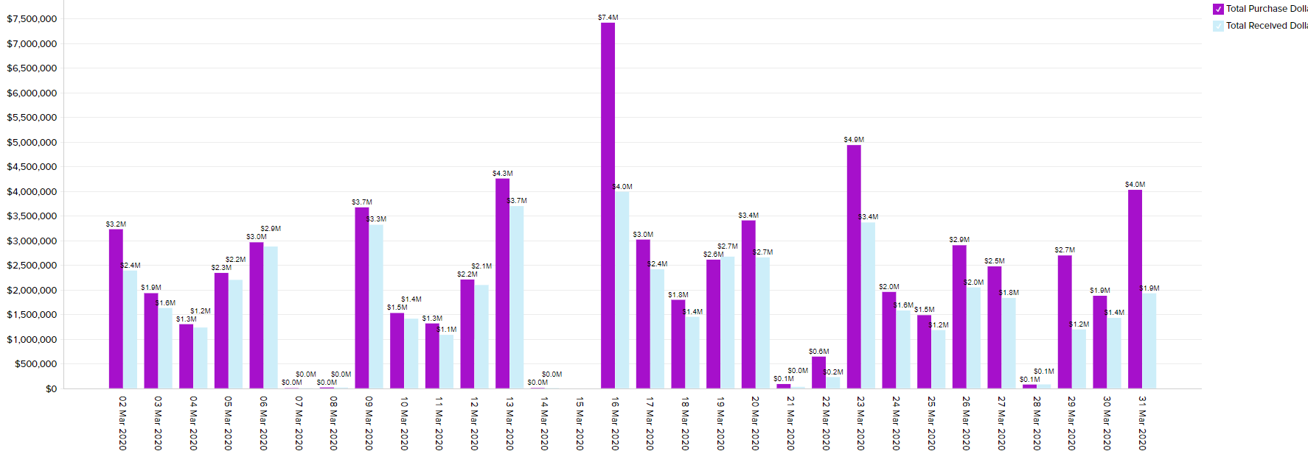
ORDER CYCLE - OPERATIONS
OPEN ORDERS
EOC
VOC
BUYMULT DAYS
ICYCLE > VCYCLE
20
14
15
67%
9Keep Watch
Take Action
Avoid Delays
9
OPEN ORDERS: POs & CASES
PAST DUE POs
PAST DUE CASES
AVG LINES / PO
1200 - 95,000
220
18,000
12.6
PURCHASED VS RECEIVED

Slide 13
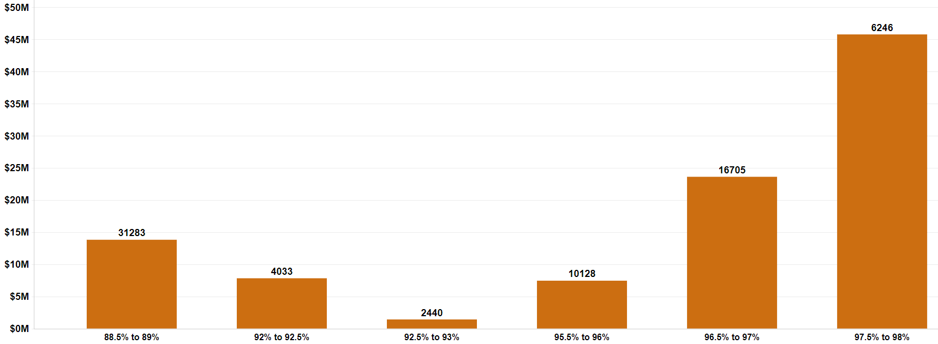
SERVICE LEVEL ANALYSIS
SERVICE STRATEGY
SERVICE LEVEL GOAL
PUTAWA L60 DAYS
PUTAWA L60 DAYS
PUTAWA L60 DAYS
98.5%
2.1%
2.1%
2.1%
PUTAWA L60 DAYS
PUTAWA L60 DAYS
PUTAWA L60 DAYS
2.1%
2.1%
2.1%
AVG SAF STOCK DAYS
10
PUTAWA L60 DAYS
PUTAWA L60 DAYS
PUTAWA L60 DAYS
2.1%
2.1%
2.1%
88%
90%
93%
96%
98%
99%

Slide 14
SERVICE LEVEL ANALYSIS
SERVICE STRATEGY
SERVICE LEVEL GOAL
PUTAWA L60 DAYS
PUTAWA L60 DAYS
PUTAWA L60 DAYS
98.5%
2.1%
2.1%
2.1%
PUTAWA L60 DAYS
PUTAWA L60 DAYS
PUTAWA L60 DAYS
2.1%
2.1%
2.1%
AVG SAF STOCK DAYS
YOUR PERFORMANCE
10 Where did you miss?
10
PUTAWA L60 DAYS
PUTAWA L60 DAYS
PUTAWA L60 DAYS
2.1%
2.1%
2.1%
88%
90%
93%
96%
98%
99%
TOP 200
NEW
SEASONAL
NON SEASONAL
MANUAL FCST
SHORT ORD CYCLE
SERVICE ATTAINED - ALL
98.6%
90.3%
99.4%
97.9%
92.7%
94.9%
98.2%
10
WATCH
SLOW
SHORT LEAD TIME
LONG LEAD TIME
SHORT LT DEV
PRIV LABEL
98.8%
95.3%
95.2%
98.7%
92.8%
99.4%

Slide 15
INVENTORY FINANCIALS
DATA into STORIES into ACTION into RESULTS
CONTINUOUS RESULTS
via THE JOURNEY

Slide 16
The Journey
I. DEMAND FORECASTING
II. LEAD TIME FORECASTING
III. ORDER CYCLE MGMT
IV. SERVICE LEVEL MGMT
V. REPLENISHMENT
MERCHANDISING
1 FORECAST ACCURACY
6 LEAD TIME FORECASTING
12 ORDER CYCLE STRATEGY
18 SERVICE LEVEL STRATEGY
22 REPLENISH: IS-IT-DUE?
27 YOUR ITEM MIX
2 SEASONAL DEM EXCELLENCE
7 LEAD TIME SEASONALITY
13 SUB & SUPER VENDORS
19 SERVICE BY NET MARGIN
23 TOP-OFF WARNINGS
28 OVERSTOCK MGMT
PERIOD-END ACTION
3 DEM FORECAST SECTORS
8 LEAD TIME SECTOR OUTLIERS
14 ITEM ECONOMICS
20 SLOW MOVER SS FOCUS
24 HELD / RESERVE & MIN
VI. SPECIAL OPPORTUNITIES
DEEP DIVES – SERVICE & FA
4 DEM EXCEPTION MGMT
9 SUPPLIER PERFORMANCE
15 BUYING MULT STRATEGY
21 SERVICE RESULTS ANALYSIS
25 DEALS / INNER MARGIN
PRESENT YOUR BUSINESS
5 NEW ITEM EXCELLENCE
10 OPEN ORDER MGMT
16 IMPORT MERCHANDISING
26 PLANS & PROMO
11 OPERATIONS HIGHLIGHTS
17 SHELF LIFE MGMT

Slide 17
Educate, Inspire & Guide Your Team to Achieve EVERY DOLLAR of Potential Profit

Slide 18
INVENTORY FINANCIALS

